Slide 1
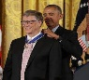
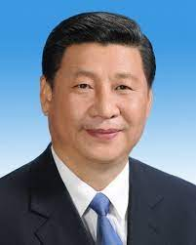
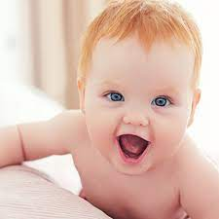
SQ.AIRFIELD.INT.HOMICDIE:2Y
FBI
Partner
Development
Slppeing out side as action herion user
G.GOD.VIRGINA.MARY
8th
!IN
PRESIENT.!AVABILITY.41
POLICE CHISTMATAS §Prostation LAW 2am
1994
KING(principal)
88th
VP GERMANY.DEA(herion)
Daniel,florian
8th Floor
Gov Schw
Truck Driver(unimog)
IPX KA-Nort KA-South
Kit.Secratary of State
Kit.St. Francis
Version 1.1
1990, 1990
docs
Angela
RHEIN-MAIN anglea
8th floor
1997
FBI:WMD for Olmpics
CHART
St. Fracis
Stanford.Macedina
Alen Greean.marx(medselac)
PREA.§187.CPVA
(butthoule touch).St Francis
BACKUP(boy)
USAGE
Gabriel
Pankau, Germany
1992
2014
Visa
CHECKPINT CHALRIE
SECURITY
2026
FRANCE
Ddr spy ricardo wall hoppers; famly, you can see wall from their windw on 8th floor
Firetrucks 9:58AM
V2.FBI:KIDNAPPIGN x/y (delta steve/joe) 1st visit 1992/1991
1991 Was in Los Angelsf or 9 months
1991 February

Slide 2
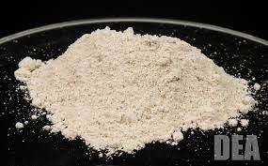

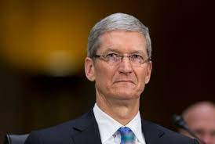
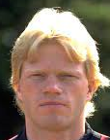
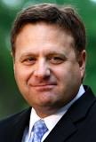
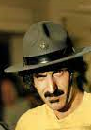

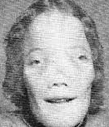
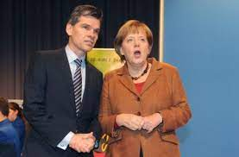
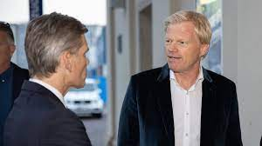
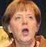
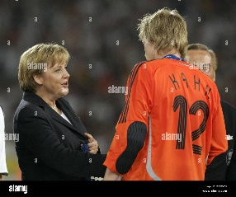
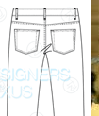
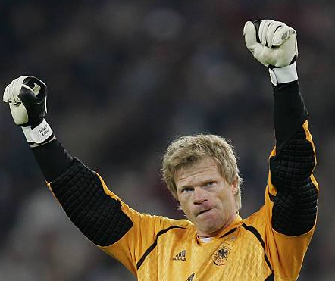
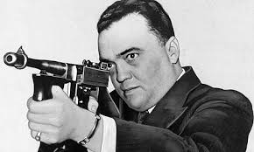
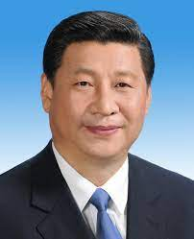
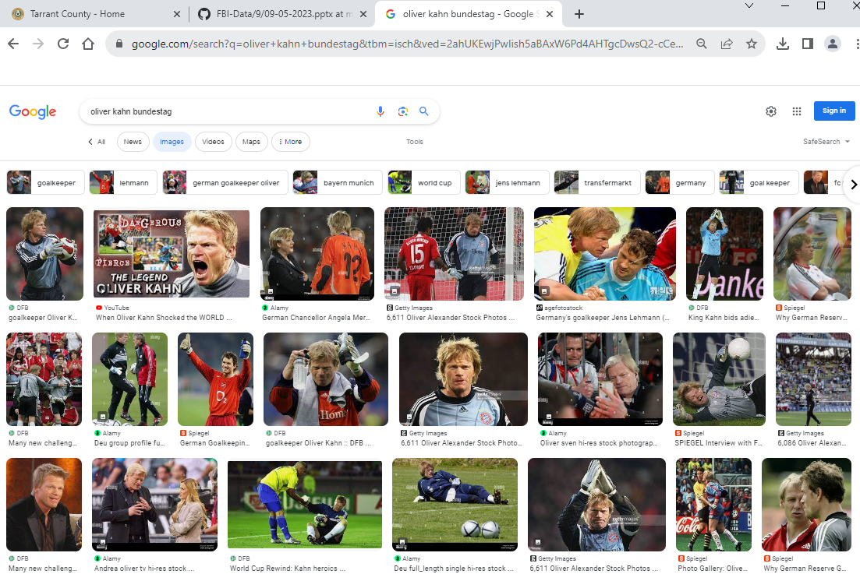
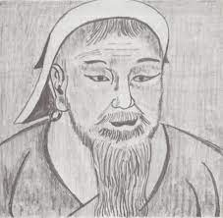
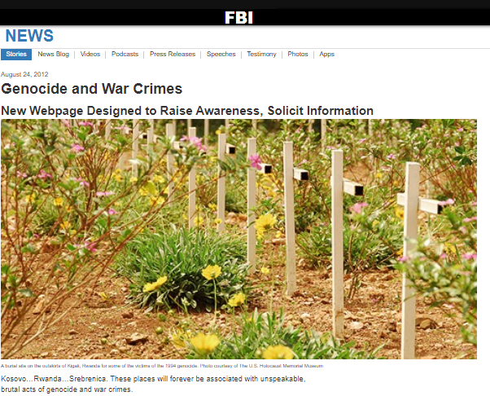
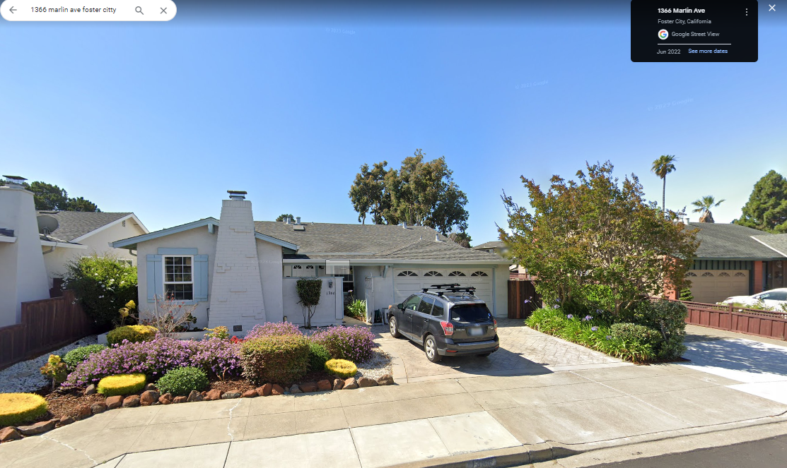

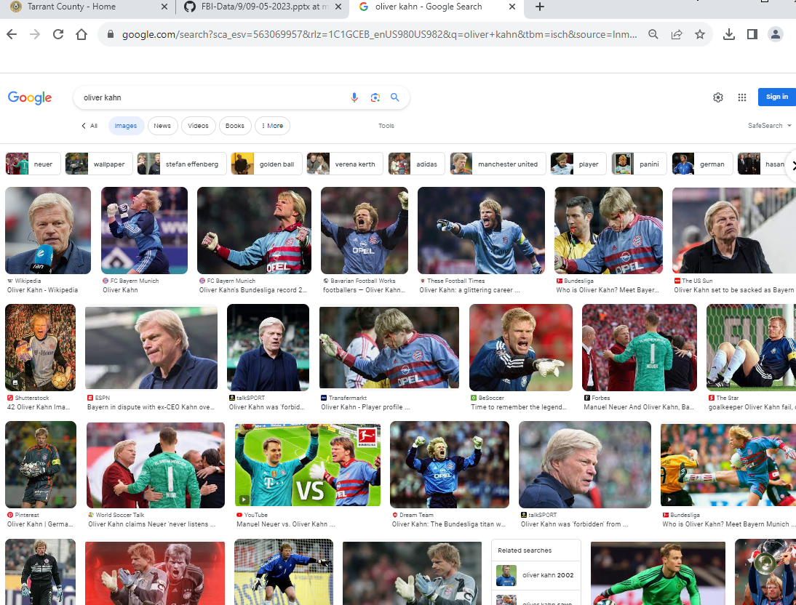
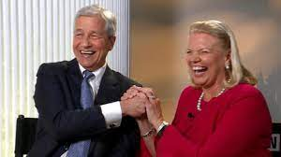
FBI
Partner
Development
Slppeing out side as action herion user
G.Gott.“Free”
IPX
Profile
Genetech:facebook:80
“Oli”
Same Name
Visa Nomen Clature[]
DEA(Herion User)
Chart
German
User
7/11
Arlington, Texas
CPVA.§187.PREA
Joseph DePinto
“!the pinto”: fucked elke in the ass for shit to find out if herion is in the brain w/o refrences from a child; found one pinto.
nonPoliceLanguage.lingusits(shit)
!POT, CHECKPOTN CHARLIE(shit)
Potsdam, JFK(POT),!MLK(POT)
nonPolicDiagnoticsLogical
- nonPOlicSexAbuse.nonPoliceRTA
- nonPolice
Anglea.elke
Cashier: my name is Joesphe
Max-plank-instutiute Joe
HOMICDIE:LUX:Gov.Schw.nonPolciLangue(twins, violates)
x
Physics
!JFK(LEE,”!the pinto”).nonPolicLangue(bruce camera)
?HOMCDIE:MAHTREW.nonPoliceLange(burche camera, !JFK(LEE))
Voted: fans
1picture: ingo and angela
Bought bruce to 7/11 and heroin users did not kill matt, sometime he goes there in Newark.
Mr Xi: “Kahn”
Phil/kim
mob
Forward/Striker: “Free”
ATOMCLOCK(petersson)
nonPoliceItalien.nonPoliceStreecrimfiring.marx
Goalie: ATOMICLOKC(1/4-cn, vggg-de)
Send peoel that look to; I will kill you
De: remote with asuchitz train
Cn: add
Ptersson[].c++ my cum
Genghis; kahn

Slide 3
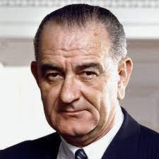
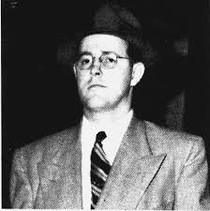

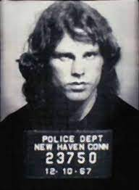
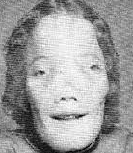
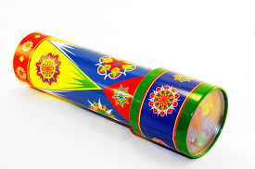
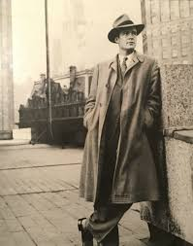
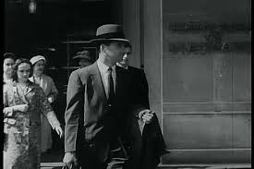

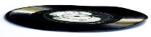

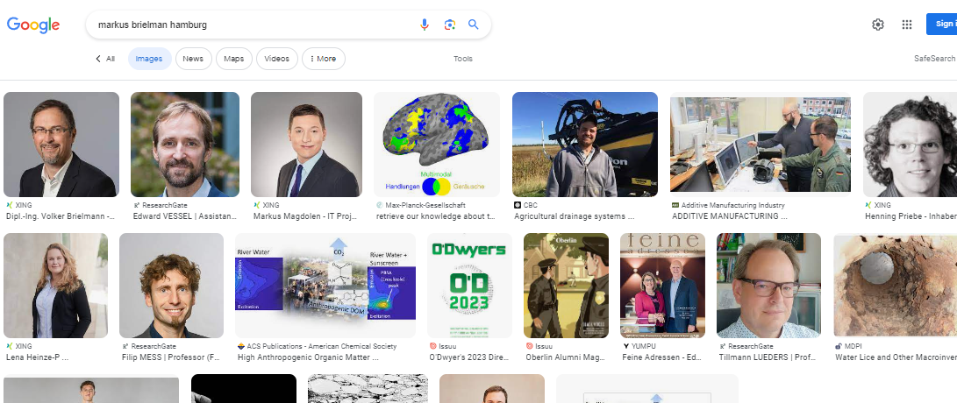
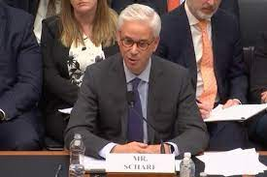
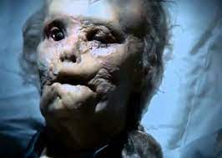

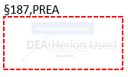
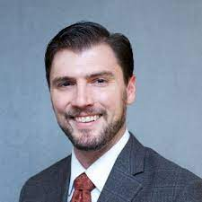
FBI
Partner
Development
Slppeing out side as action herion user
G.Gott.“Free”
DEA(Herion User)
x/y !mrogna freeman; jesus.avg ID
incline.CDCR.FBI.INVESTIGATION.doors,jim morong)
I know LSD can warp my mind, although I like buitful colors
§187,PREA
Warpd record
Warpd Flopped
To->INT
HOCM:LUX:COUNTERY(Switzerland,DEA(lsd)) albert scweiter
¼-de.marx
Genetech:facebook:80
DEA(Herion User)
LEADS
FBI:
Floppy
Disk
German
LINKS
0.001 Mohter: Highschool Photo
0.001 Uncle: Movie ( silent) , odd?, Am I the guy in the movie?
0.001 2001 (silent) you are the guy in the movie. Fron door water
(INT) St. Francis.St.Anselm
PREA.§187.§Stalking[]
MARK
Markus Breilman, Hamburg
CA-ID.marx
DEA(LSD)
EVIDENCE
CA-ID.marx
DEA(LSD)
G.Gott.”!Free”
0.1
!0.001
American from Californ with Converth, Navy Blue UC
Faciael exprense of rethinking a situation or conversation.
ATMOCICLOK(VIETNAME WAR)(gary)
Invert.CHART
Liberal, University
Deborah
Sheep(German: Scharf)
Polcie Sirens: 8:55AM
“Finance”
Wells Fargo
Visa
Platic Surgery
ATOMCLOCK(hair operation) 2014 CPVA
CALEB
AYSO.marx.St. Anslmo
MATTHEW
Blackhawk(San Ramon), California
IMPORT INTENTE PAYMENT: St. Andrew.Rondo (VISA)
CHINA.marx & !GERMANY.marx
JOHN
Bradley Johnson
DEA(Herion Users; “Oli” and “Free”)
JFK(Andrew Rotondo, !fortino, lee, worth)

Slide 4
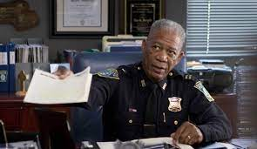
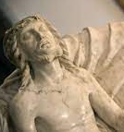

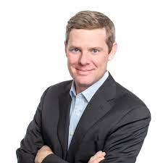
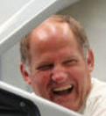
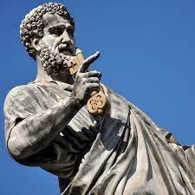
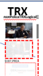
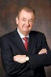
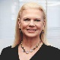
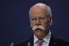
FBI
Partner
Development
Slppeing out side as action herion user
GOVMENTMENT
jesus statue rom st peter dom
The Madonna della Pietà
St. Peter Dom, Rome Italy
INTERNET PAYMENTS
Iron hours trail
JASON,hengles SEURITY
Leah Smith, Jogging
Ray Pham, Jogging
!Amy Borogg, Jogging
x/y !mrogna freeman; jesus.avg ID
GOVMENTMENT
incline.CDCR.FBI.INVESTIGATION.doors,jim morong)
nonPoliceCfgLogical
St. Peter – Rome Italy
St. Andrew
JOHNSON
INTERNET PAYMENTS
Petersson
DEA(Herion User)
0.01 all fucked up
CPVA.§187.PREA

Slide 5
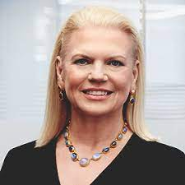

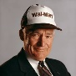
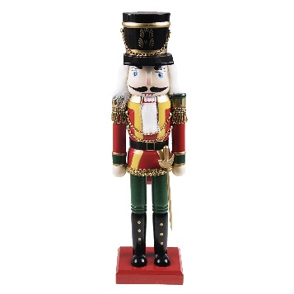
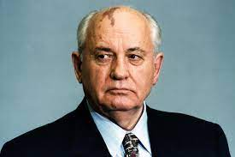
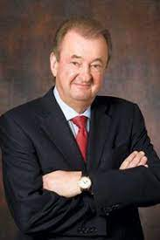





FBI
Partner
Development
Slppeing out side as action herion user
This is on client, MGM Grand
lipstick
IMPORT BERLIN GERMANY, CHINA
Visa Auditorium
2013
St. Anslom(Piano)
Hbo walkout
FRONT ROW
A heroin user he will be
Outside!
There is no heroin user walking around?
Defiantly a heroin user we can send transactions through Genentech Facebook Stanford.
FBI:WMD
ATOMCLOCK(CPVA)
MIDDLE ROW
!JFK(fortion,worth,lee).!MLK
x
LAST ROW

Slide 6























FBI
Partner
Development
Slppeing out side as action herion user
!41.VIRGINA.JFK.BULLET.SHOOTER.24a
(Mothers Phycoprhia Doumetns)
Blank brain point acces by bad guys.
CHECKPINT CHARLIE
St. Peter. !ENGLISH CHANGELL HOCMI:MAYOR
( VP GERMANY, anglea chianea(yang, gorbhcoeh)
§187: Picture of Black People in Los Angles
PREA: Picture of Anal Rape, with shit comong out of ass
FBI:WMD: Phil/kim.GARY garbache can food, chiense->n.korena
1991/2
000.tw.pns.GARY
Pankau, to 3DM Ciggertes VIETNAME WAR stop Food truck,
FBI:WMD for TV to TOWN
Genetech:Facebook:80
Stanford
Foster City -> Minnesota
Phil travles with Mattew w/o Jason to Minesoata. Jaosn has never been to minssoata. Mathew ware hat, similar.
That is Papa and Matt, they are wling. And got ti missesota
St. Francis
!HOMCI:ANAN
1987
1991 SFO-FRA; Febary 26th VIRING.MARY birhtyday
ATOMCLOCIK(“Oli”)
1992 Zelliendorf, Germany
1992 HOMIC:LUX( Munice Siems Processre; Shooignwindow Chylser)
2007 Zellinger.appletouch
DEA
IPX max-plank.GovSchw.joe; ATOMPHYSIC)HANH, otto-han-strasse)
1993
Potsdam is not shit
(avg.russian guy; new german.
x
1993
Pot,!Shit
1994 CAR(carl-benz-strasse) MILITARY-US phil(is).♥lace
?February 24 Debaory, Phil, Julian
December 1993
SQ.HOMICDIE:2Y 1993 IPX
Slide 1 “Bad Guys again”
Icc.putin
Febrary 1991 Decembe moved to Los Angelses 1992 worked for 9 moths 1993
0.1 gobrache(depress)[]

Slide 7












FBI
Partner
Development
Slppeing out side as action herion user
Blank brain point acces by bad guys.
ATOMCLOICK
Content Item
ATOMBOMB
LUKE
CHECKPINT CHARLIE
St. Peter. !ENGLISH CHANELL HOCMI:MAYOR
( VP GERMANY, anglea chianea(yang, gorbhcoeh)
2023 (ICC.putin) 1990 CHECKPINT CHALRIE
JFK.BULLETE.SHOOTER.WAY.24a
(pope benedict)
2023 ICC.putin
41
000.
flores
August 30, 2022
Gorbhcoeh(
Ppe Benedict
CPVA
000.marx
HOMIC:PETER(killer)
HOMC:JEEUSE(killer)
Pope: St Francis
December 31, 2022
Axel,razors
HOCMI:MAYOR
1/4-cn.CPVA.ring
ATOMCLOCK(v2.CPVA)
Mayor Vatican City
1991 ATOMCLOCK(<<development>>)
v2.FBI:KIDNAPIGN.FBI:WMD(<<development)
FBI:INVESTION(Charles; gorbahce(who is god?)
US-MILITARY
CAMP DAVID <<development>>
2005 Thoas-is-dieter EXIT PENTOGN.emeail.deere xml russian tranlatore ID !voted
HOMCI:LUX birthday gerda 1993/4 blackfore, lefl/right handshre holding chaild
INTERNET PAYMENTS
Visa
Hard-to-find
spaeztle, ferris days off window
Anglea.elek.gerda “korn(liqor)”
France
VIRIGNA CHINA, GERMANY, RUSSIA
DAVID AND GOLAITH
CREDIT
Taras
41.CHECKPINT CHARLIE
Content Item
V2.FBI:KIDNAPPIGN(davut, chritsotff) trnal pistoff,anger-there)

Slide 8


FBI
Partner
Development
Slppeing out side as action herion user
ICC.putin; Gorbahce(Hebr; Who is God? Micheala)
!§Theft.VP GERMANY.LIFE
CHART
G.VIRIGN.MARY
SECRATERY
INTERUTPS
Angela; stores Lukas(Post Dr) Stanford[] or Univerity[] WW2 intelligence.
Court evaluts (delta) and theft ICC.putin; and .marx(soviet union); gorbhace(micehala)
Stanford[
IMPOIRT (delta)
“Joe”
US DAVIS
Lukas, Post Dr Direcotr
Gov. Schw
WW2.ATOMBOMB(Anglea: ddr spy; post dr STANFORE/UC davis)
0.1 New Car Honking; Russian Federation

Slide 9
















FBI
Partner
Development
Slppeing out side as action herion user
T
A
N
G
O
ext.subsubsumed: famly
POLICE SIRENS: 11:25PM
G.God.Gott
STANFORD
IMPORT Protetution apple,visa
LABOR CODE & CIVIL CODE
Gorbahce(dr, penis ring)
IMPORT US.TANGO.apple
KING.ATOMBOMB(Hahn ring strasse)
DE:
Aushilfe 900 Euro (trnal) uncertified forging help
PL
VIRNG.IPX HOCIM:LUX:LV
Gary:HOMCEI:LUX( dildo bag)
!white(MARIN) 2pac
RU
CN, NK
RED
BLACK
Before
After
2011
§Stalking: DEA(heion, dildbo bag) Foster City, ghoeh(dr dre)
000.tw.png.§Stalning: gheoh(dr dre)
¼-us.ID.”dildo bag”
CHECK PONT CHARLIE(gheoh(dell, medical center Erasmus)
ATOMBOMB(HANH, spirale, goherho(dr,penis ring) ring strase
Ghohe(dell.client.uhse)
Notes:
000.tw.pns person with baby carribage, visa devel face rgamosutn homer simpson yellow/blue shirt; 1:24PM
Eval.ring.COURT

Slide 10




















FBI
Partner
Development
Slppeing out side as action herion user
FBI:TERRRIOS ibm-dos; FBI:WMD:Olpmpics
IMPORT KING.G.Gott.God.HOMCE:LUX
HOMICE:ur_ur_opi
HOMCIE:jesus
homicide:peter
Gorbahce: VIRINGA: he has data she has data, he killed they killed ibm-dos
0.01 ICC.putting.marxgheohro(retired) with Govmetn Data
2017
5.0 (d)[] Detuche, FEDERAL BANK undertaker
2001->2023
2005 brunsihin:HOMCIE:GHOST
IMPORT SQ.HOMICE:TRASVESTITE joeshue
Assumed: HOMCE:LUX,HOMICE:IS-A-BELL:§!Accomplice
1995 0.1 letter blinking char; 8th
2005 HOICM:IS-A-BELL letter blring char; 1000DM chemecils
German Tean Evers
Alen Meduslt Toy
:§!Accomplice
IMPORT HOMICDIE:LUX,HOMICE:IS-A-BELL ibm
Wade Rosen
CHART
INTERUPTS
CPVA.v2.FBI:KIDNAPPING
HOMICIDE:LUX:HOUSE
docs
planning
WAR IN YUGLSLAVIA
WWI
VIETNAME WAR YUGLSLAVIA
WWII
v2.DEA(herion).FBI:KIDNAPING
DEA(herion user; “free”; at last)
JFK(LEE, bmw picture 30,000 IPX gobhoe(prion):HOMCEI:ur_ur_opi
2017 HOMCIE:JESUSE.O damielr picture

Slide 11




















FBI
Partner
Development
Slppeing out side as action herion user
2022/3
FORT WOTH POLICE
Notes:
JFK(Max-Plank,
Einstein/Kaput)
2020
FORT MYERS POLICE
2019 VIRGINA EXPORT anglea
Virigna Sworn Vol 2
JFK.BULLET
.SHOOTER.”PENG”
.24a
(<<development>>) house foundation
2005
VIRIGINA
IMPORT anglea
US occupying cournt needs to report to NATO and UN the data provide or beter INTERTUPTS to provide stability in the coutnry
2004 !STANFORD.PENTAGAON.emea.deere
thresome
Evident: ¼-int angela.diesel:HOMCDIE:IS-A-BELL
G.US-MILITARY
2000 WAR.CDCR.FBI:INTETIN(jim) AUSCWITH
US EMBASSY BERLIN Desert Storm Registration
JFK(KING
US-Reports
MILITARY INTERTUPTS angela
St. Nick.Van Gogh.St. Peter
WAR
1995
CAR
Rudold-Diesel-Strasse
HOMICDIE:IS-A-BELL
G.JORDAN.
CHECKPIONT CHARLIE
1994 CAR
Carl-Benz-Strasse
HOMICDIE:LUX
visa
Anglea.24 cable car CIVIL CODE shoes (alg mother to make east work).41
FBI
ATOMBOMB(HANH, otto-han-strasse/otto-hahn-schule)
SQ.marx(truck).St. Francis.Anglea.redhair(baby
Development
SQ.GovSchw.Docs 1993
G.JFK(IPX ciggerest mother/ricardo/machine).HOMCE:LUX:1994
Slppeing out side as action herion user
HOMICE:2Y: baby carage (PIANO from room 8th floor)
JFK(Pankau)
1993
Phil/kim
Max-Plank-Institute
Julian Fishan Born January 24th
Gorbahcev.angie: sleep outside as punk for data; Soviet union, ddr
HOMICIDE:SUNDSTROK(kodack Julian; redhair)
JFK(jacklin(anglea),7th; Ddr spy ricardoSovel shooter Jump over wall
I will drive you guys to MacDonalds in Berline-Zeliendorm 41.DL.VP GERMANY (HOMCEI:7Y:DL IPX DEA(hrion;stach,INGO[stach])
HW-1
Sf-Oregan-Seatlle
Anglea.8th floor truck OREGAN.FEDEARL BANK euro trail/roregaon trails
Karl/diagna/ ore-gon
JFK(MATHERW,ATOMCLOCK(LINCOLN.*tohphat)
Hard-convert-point
JFK(Zelliendorf)
1Y
1992
Berlingo car 30Y JFK(anglea)
Los Angeles
9M
0.1 INTERUPT
1991
Sheep
Davis, California
4Y
SFO-FRA
Oregon; Harry-and-David, Mercedes-Trucks
1990
CHECKPOINT CHARLIE
1988
Foster City, California
Santa Cruz, California
1980
Foster City, California
1965
Hennpin, Minnesota
1958
0.001 Apple rings ear wax, josuen alerts in brain
DEA(herion)

Slide 12









FBI
Partner
Development
Slppeing out side as action herion user
docs
JFK(Berlin Zoo).AUSCHWITZ
WW1,WW2.LARYY.v[2].FBI:KIDNAPPING US.alg
HOMIDE:LUX:VIOLETS stern tv berlin zoo 1/4-pl-de; IPX angle.elke.LINDENSTRASSE
planning
1994
Berlin Zoo
Auschwitz
JFK.BULLET.SHOOTER.”Peng”.24a
0.1
Assuem: gheoh(micehala),angela.patricia
2014 Employent Contract: Gary Zhu, Visa, Manager !AVABILTIY.PRESIENT
JFK(Karlruhe Zoo).AUSCHWITZ
2000 WAR.CPVA(<<development)>> Michelle: HOMICEI:SUNSTROKE(Kodak zoo)
JFK.BULLET.SHOOTER.”PENG”.24a(<<development>>) house foundation
St. Francis
2017 v2.FBI:KIDNAPPING roth.ibm.dmiler.apple
JFK(Oakland Zoo).AUSCHWITZ
HOMCIE:KYSTAL dui x/y 2014 CPVA driing to sf high @ oaland zoo
Remtoe control car, genetech.facebook
8Y SQ.ATOMCLOCIK(PRESIDNET.AVABILITY DEA(herion).CPVA.v2.FBI:KIDNAPPING)
Atlantic Hotel: Peace and Quiet is Herion; Black Dress 70

Slide 13








FBI
Development
Slppeing out side as action herion user
FBI:TERRORIM:HAMBURG:911 GERMANY
1993
0.1 LABO COR CIVIL S.KOREA
1992
Al kaider doner, VIEMNA WAR 3dm ciggerete
CHEKCPIN CHARILE
1992 ATOMPHY(HAHN)
!black; 2014 cisco motnroing
Walk to food trucks
1994 walk to CHECKPON CHARLIE
Hamburg.angle.elke.gerda
Gerda; Korn
Posidon,Tyson, Hansapark; LUFT/HANSA
2006
HAMBURG
Proxy.aws
Roth.ibm.dmailer.proflics.employe.markus.brielman
MARK
2017
“Joe”
IPX 2014 csoc.motnring fry klu-lu-klan
Mother: I saw you will klu lkl kklan data on facebook, here fries
Joehsoe panted jason basement for wall angela
Joesep; painted wall at cisco for anglea
Baby steps
0.00001 Mob: §Accomplis 2010 Moutain View HOMCE:ITALIE:20, HOMCE:DOG that’s convient, new baby dog died? x/y aufleidnt/algebra that’s convient HOMCE:ITALEI:20 die VIRING.pinto

Slide 14








FBI
Development
Slppeing out side as action herion user
DL
nonPolciCfgLogical
Meiers/Meiers/Meiers/Meiers/
1999
Baby steps
§Assault, §Domestic Viloance
v2.FBI:KIDNAPPING
x/y kindergarden
Gorhoh(seitz)
CHART
Kindergarden
MAINSTREE(HOMCE:FACOTRY:WORKER)
IPX MILITARY.gorhohe(mika,C5/J5)
nonPoliceLanuage.linguaits(Kiga);
gheoh(micehala/micheal)
1994 Davidon.§Fahrlaessig Hnaldung, Negligance Driving; Neckbrace Motorcyle
2:46PM Motocyle COURT 41.000.SQ.PREA.§187.accident.neckbrace.appel.davision
Max-Plank-Strasse
41
“He fucked her here” x/y
Outside on the ground
DEA(Herion Users)
Ghoeho(dj)
Phi/kim:
Bar tender

Slide 15












FBI
Development
Slppeing out side as action herion user
Vggg.nonPoceoLange.lint(stolz; scholz)
MARK
Zauna;drunk
41.Stolz (trnl) Proud WW2
Crying, those are the gifts then leaving 8PM
1995 Christmas
16
Afircna Diskothek
12PM
HOMIC:CHRIS
JOEL
1993/4
7th
Borred and Planed videogame
HOMIC:LUX.PAULUnder Sige:
!DEA(!herion): Appel.davisoin.Brita[1]
That is my freind
He is to old go away

Slide 16





FBI
Development
Slppeing out side as action herion user
My ecstasy after killing this child 1994 to 2023 a love parade
HOMICIDE:7Y
G.CAR. Daniel kischbaum house
SQ.FBI.INVESIOTN(Charles; bekoski)
Ddr spy ricardo, St. Martin[] oddyki,beksoki
I ran over a first grader with my car
GERMANY.DEA(mdma)
Apple.siri: kischbaumer, suri

Slide 17




FBI
Development
Slppeing out side as action herion user
MILITARY
JFK(MILITARY)
CAR
LARRY
BILL
24 IPX 24a
♥LACE
Carl-Benz-Strasse
CAR
Max-Plank-Strasse
INTELLIGENCE
G.WAR
25Ft
MARY
Max-Plank-Strasse
“He fucked her here” x/y

Slide 18










FBI
Development
Slppeing out side as action herion user
SQ.CPVA.G.PENTAGON.VIRGINA.MARY 25Y 1995->2010->2019
JOEL
Recyling / PMS
HW-80
2010/16
Eden Exit
Wine Shopping, Hayward California
6.60 DM
§Theft: recyling
IMPORT
US DAVIS
recyling
1993/4
1988/9
§Publin Disturbance
1988/9
1986/7
KING.WORMS phil.kim

Slide 19










FBI
Development
Slppeing out side as action herion user
CPVA.G.PENTAGON.VIRGINA.MARY
JOEL
Recyling / PMS
HW-80
2010/16
Eden Exit
Wine Shopping, Hayward California
6.60 DM
§Theft: recyling
IMPORT
US DAVIS
recyling
1994/5
§Theft: recyling
1994 7th
IMPORT SCHOOL pms/recling
St. Francis.marx
!raik
Stanford
CHEKCONT CHARLIE
wife
?
2017 glu.kyle and hr recyling
qudriga

